Slide 1
Insights from data
Exercises
The main aim is not just to follow instructions – the main aim is to give you some ideas, as well as, courage you to find out useful insights from the data

Slide 2
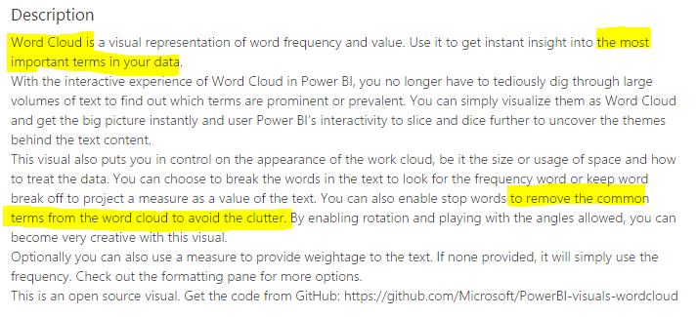
How to interpret the exercises?
There are both text and snipped pictures within purple and yellow marks to quide you
constant width (i.e., courier font) used to refer program elements such as commands, data types, function names and packages.
constant width bold and italic shows commands or other text that should be typed literally or replaced with user-supplied values or by values that are determined (e.g., selected) by context
The source of the descriptions (the title Description) is Power BI Desktop

Slide 3
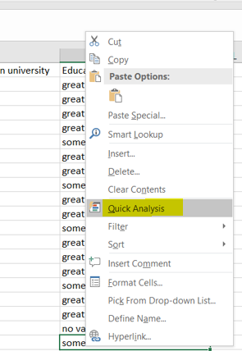
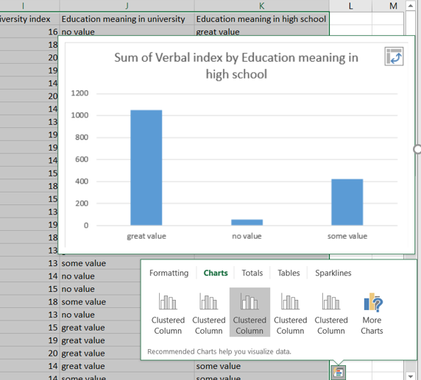
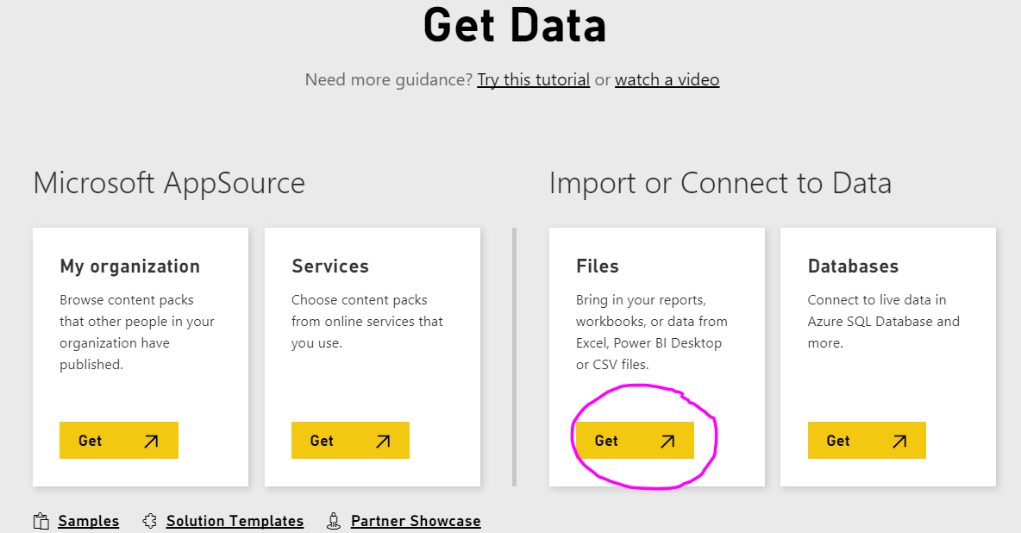
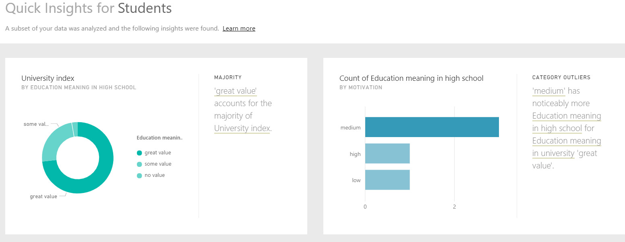
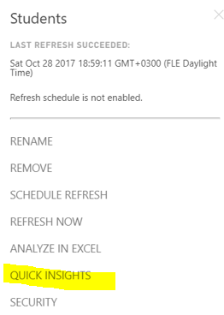
1. Learn to use quick analysis and quick insights
Upload the Excel file Students from Moodle
Open the file with Excel and click the right button of the mouse to get Quick Analysis
Explain Charts and Tables
Open the file with Power BI Service (https://powerbi.microsoft.com/en-us/, Get Data => Files => Local File => Import) and Get Quick Insights (after Your dataset is ready or using the right button of the mouse to get QUICK INSIGHTS)
Explain insights

Slide 4
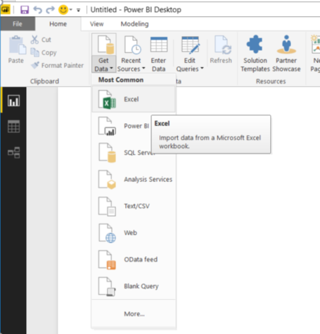
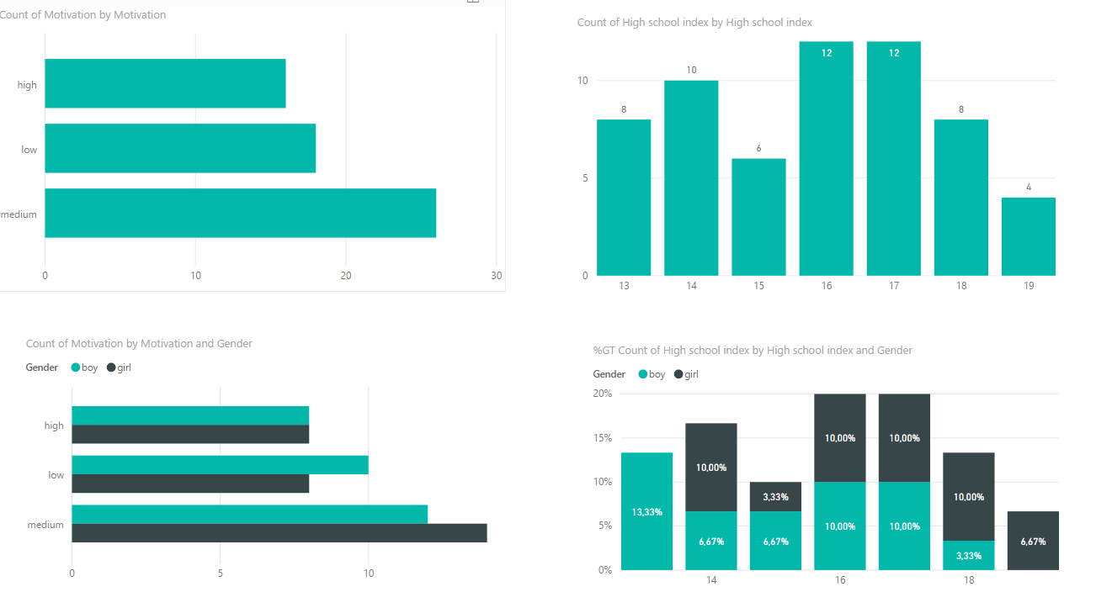
2. Learn to use bars
Review Graph Selection Matrix (http://www.perceptualedge.com/articles/misc/Graph_Selection_Matrix.pdf).
Import the Excel file Students into Power BI Desktop (Get Data => Excel)
Make bar charts and illustrate variations within categories and variations within measures

Slide 5
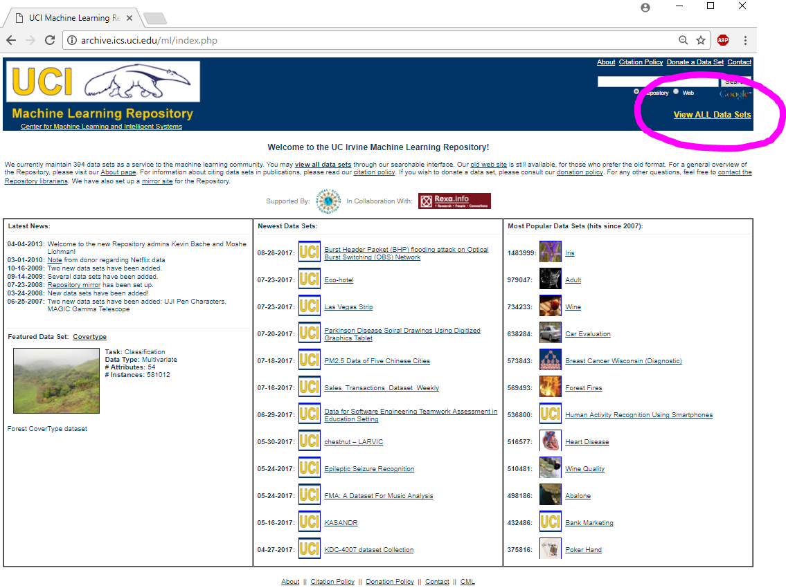
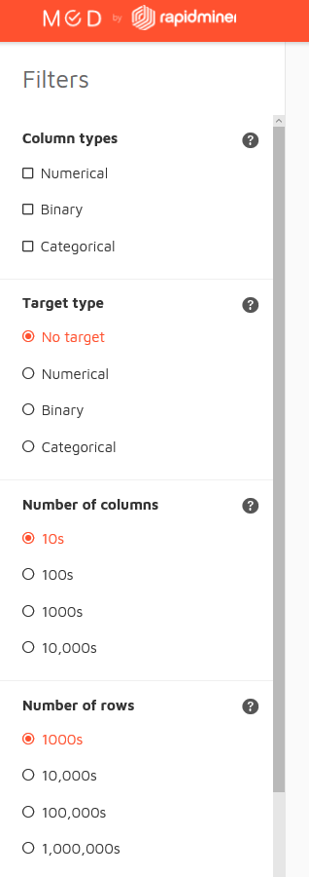
3. Learn charateristics of data sets
Review UCI http://archive.ics.uci.edu/ml
Review MOD http://mod.rapidminer.com/#app
Compare the characteristics of MOD and UCI (i.e., similarities and differences)

Slide 6
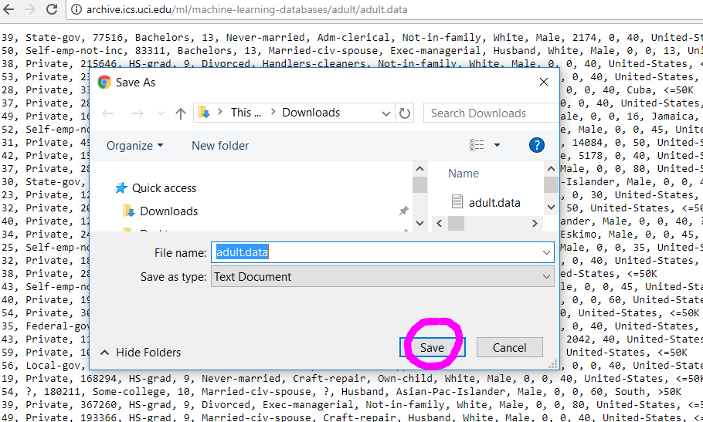
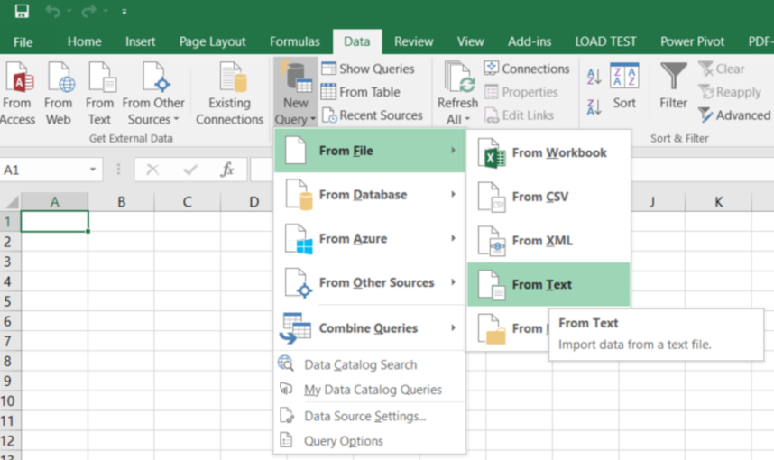
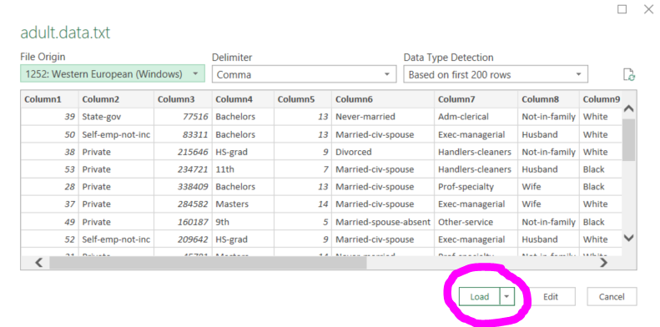
4. Learn import datasets within Excel queries
Download Adult Data Set http://archive.ics.uci.edu/ml/datasets/Adult
Import the dowloaded data set (i.e., adult.data.text) within New Query => From Text

Slide 7
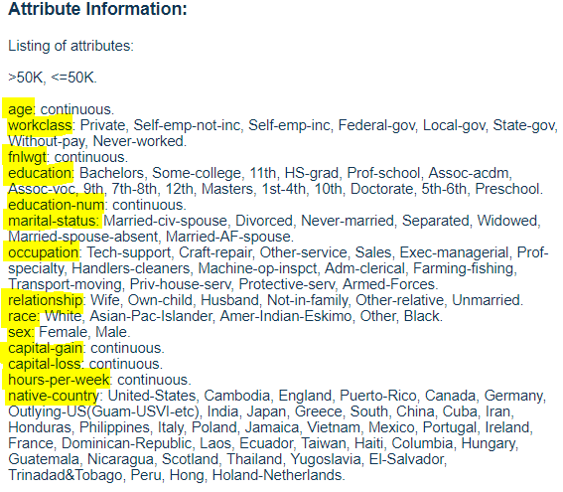
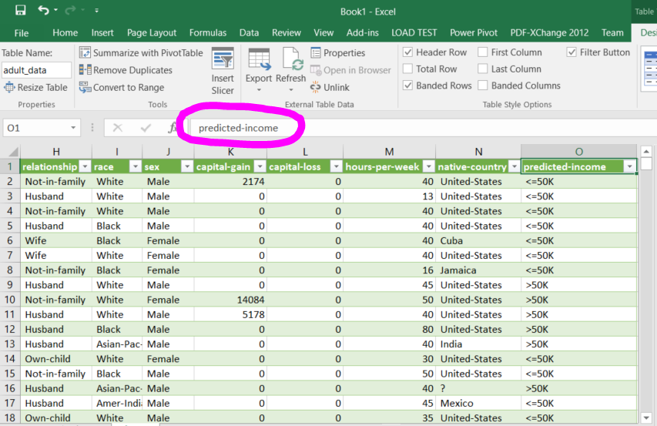
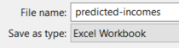
5. Learn dataset modifications within Excel queries
Fields (i.e., columns) do not have names. Therefore, rename 15 columns (i.e., attributes) by using the Adult Data Set attribute information (http://archive.ics.uci.edu/ml/datasets/Adult)
Save the modified file (File => Save As) using the name predicted-incomes

Slide 8
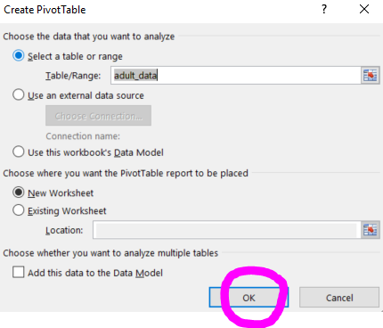
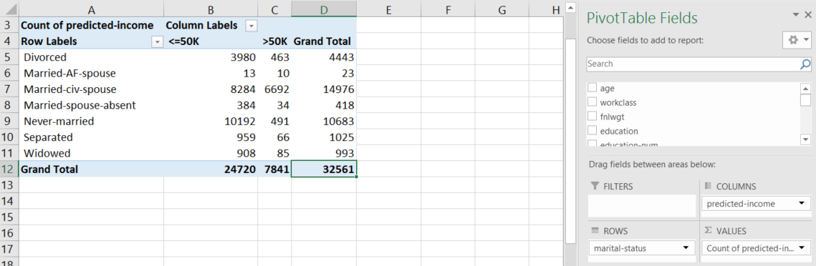
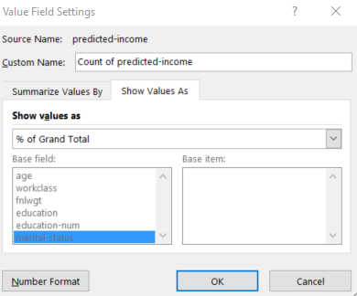
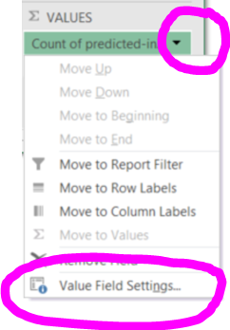
6. Learn pivot tables within Excel
Use the predicted-incomes dataset
Create a pivot table Insert => PivotTable => Create PivotTable
Cross-tabulate fields (i.e., attributes) marital-status and predicted-income
Observe that predicted-income has to be selected twice, i.e., for labeling the columns and for summarizing the cross-tabulated fields
Modify the pivot table to answer the question ”What is the marital status of the biggest group of the predicted incomes?”
Answer by % of Grand total (i.e., Show values as % of Grand total)
Study the recommended pivot tables (Insert => Recommended PivotTables)

Slide 9
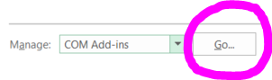
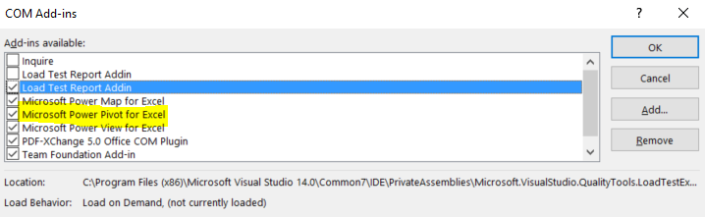
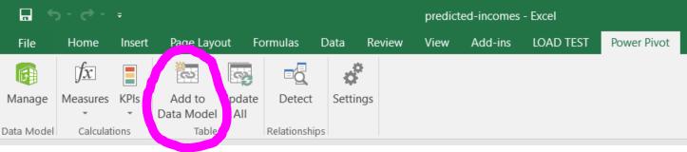
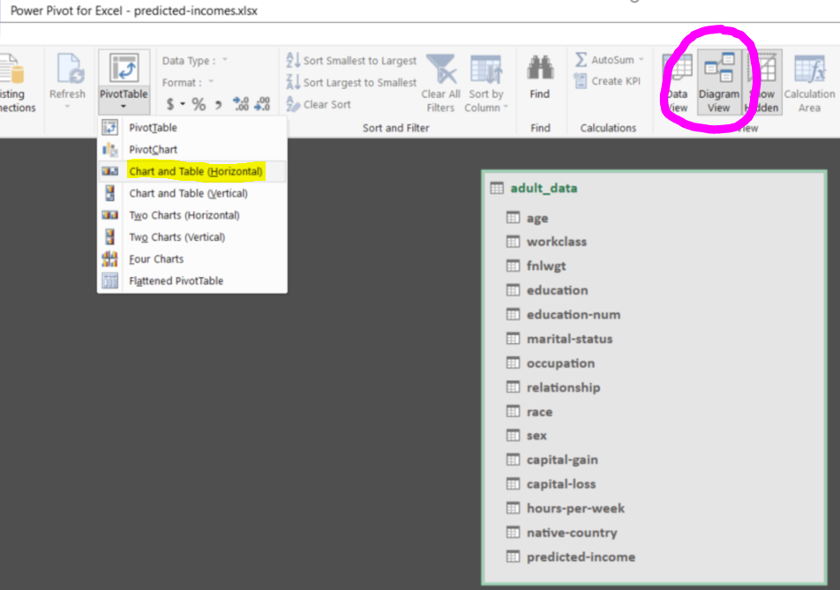
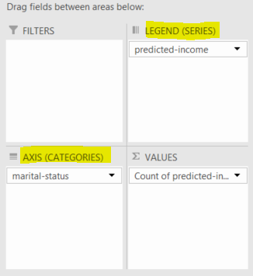
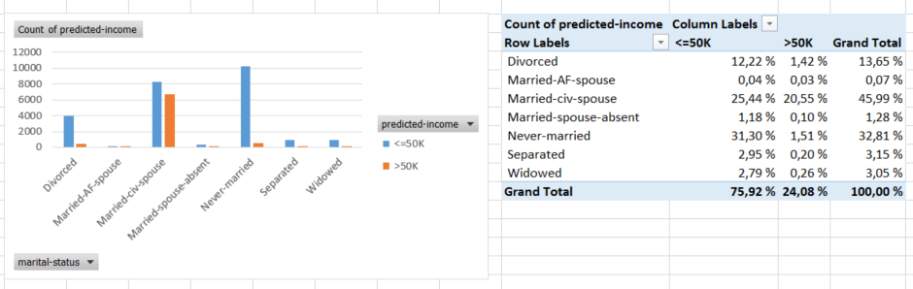
7. Learn slicing and dicing within Excel PowerPivot
Set COM Add-ins (File => Options => Add-ins => Manage)
Add the predicted-incomes dataset to the in-memory data model (Power Pivot => Add to Data Model)
Make a chart and table (PivotTable => Chart and Table (Horizontal))
Cross-tabulate fields (i.e., attributes) marital-status and predicted-income
Make chart in where the legend is predicted-income and the axis is marital-status

Slide 10
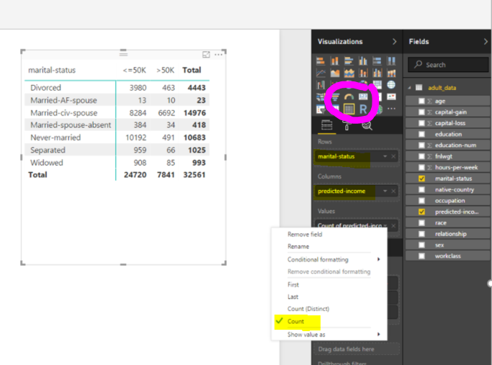
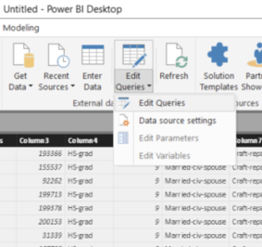
8. Learn matrix within Power BI Desktop
Review the video Why Pivot Tables? (https://exceljet.net/plc/why-pivot-tables)
Practice to edit queries and import predicted-incomes (Get Data => Excel)
Select the Matrix visualization (Visualizations => Matrix)
Cross-tabulate fields (i.e., attributes) marital-status and predicted-income

Slide 11
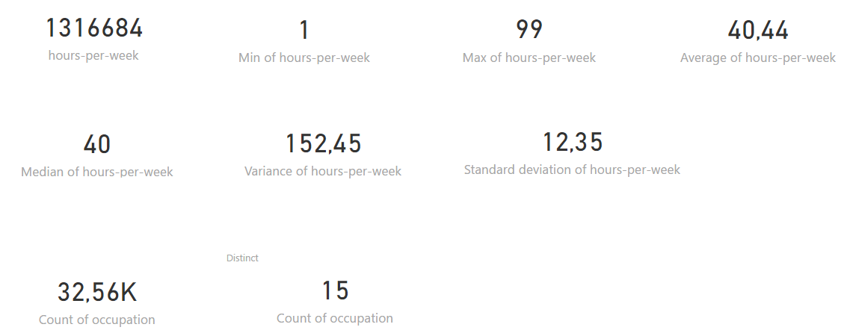
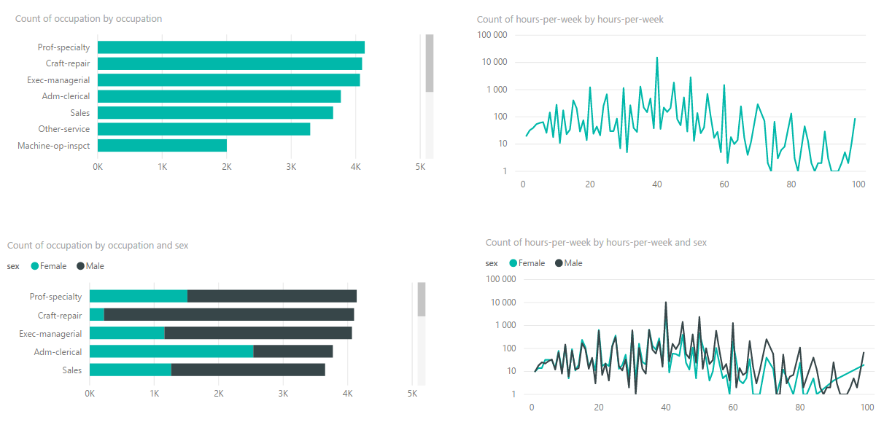
9. Learn aggregations within Power BI Desktop
Review Aggregates in Power BI (https://powerbi.microsoft.com/en-us/documentation/powerbi-service-aggregates/)
Explain Median, Variance and Standard deviation
Review Measures in Power BI Desktop (https://powerbi.microsoft.com/en-us/documentation/powerbi-desktop-measures/)
Use the predicted-incomes dataset and illustrate the followings:
Variation within categories, use Bar chart and use e.g., occupation data field
Variation within measures (i.e., distribution relationships), use Line chart and use e.g., hour-per-week data field
Relationships among categories (e.g., occupation data field), add Legend (e.g., sex data field)
Relatioships among measures (use e.g., hour-per-week data field), add Legend (e.g., sex data field)

Slide 12
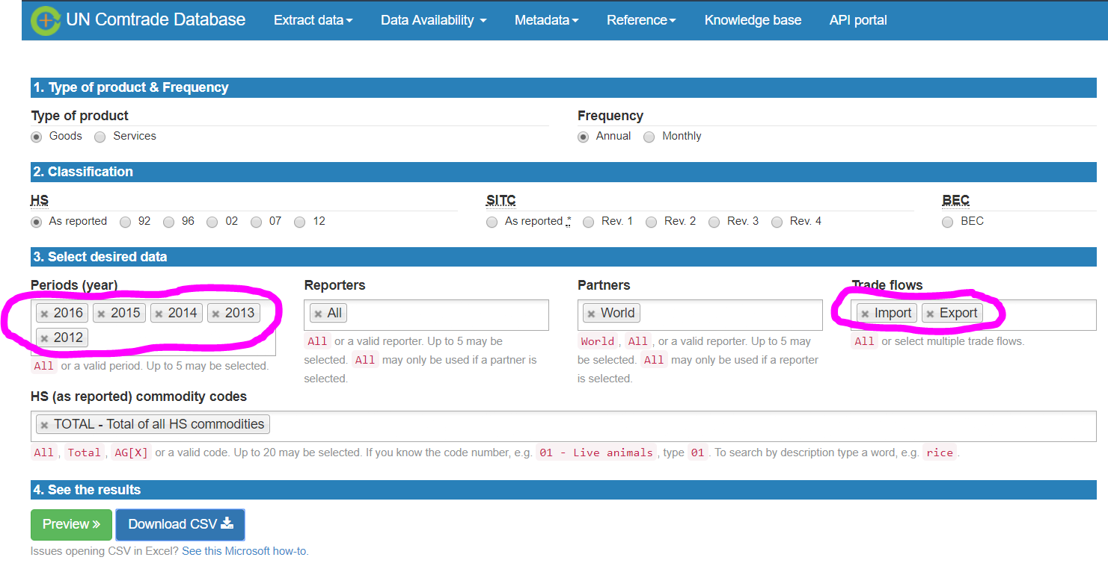
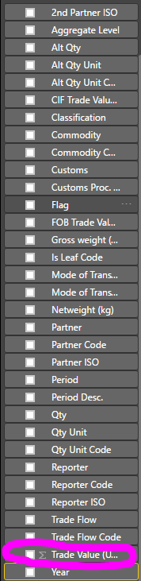
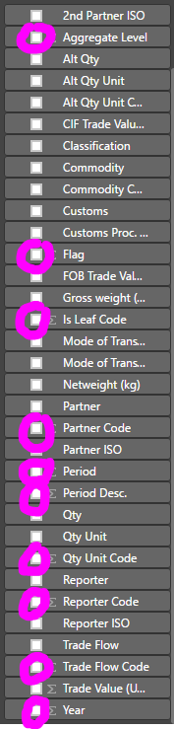
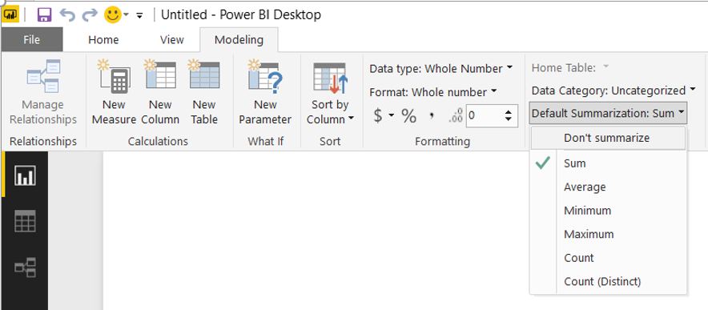
10. Learn modeling within Power BI Desktop
Get detailed global trade data from UN Comtrade (https://comtrade.un.org/data/)
Import contrade.csv (Get Data => Text/CSV)
Change the default summarization of the fields (Modeling => Default Summarization => Don’t summarize)
Only Trade Value (US$) is summarized

Slide 13
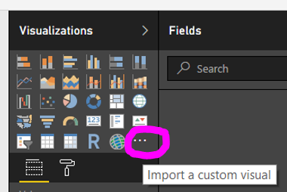
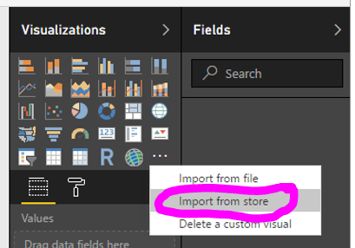
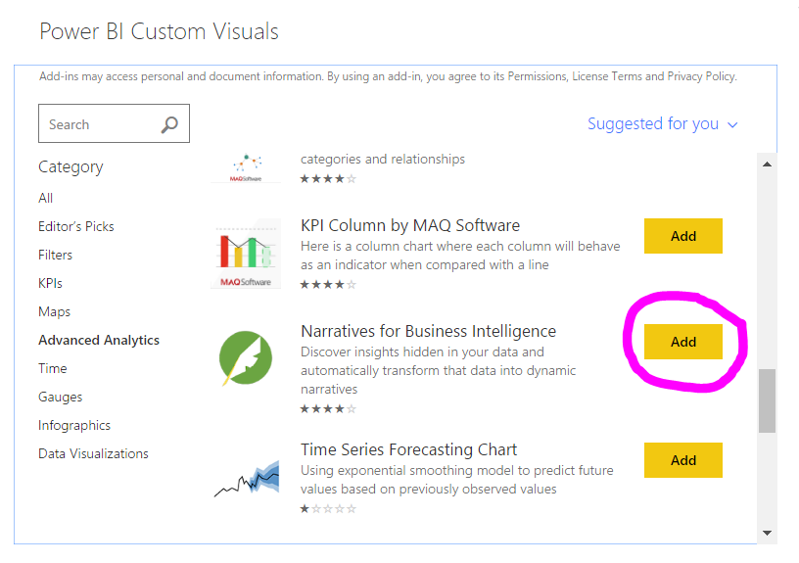
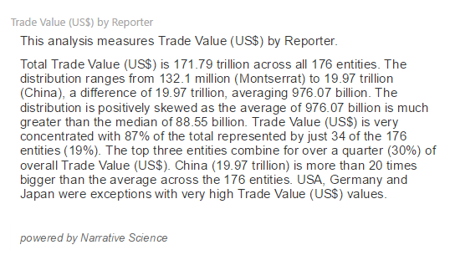
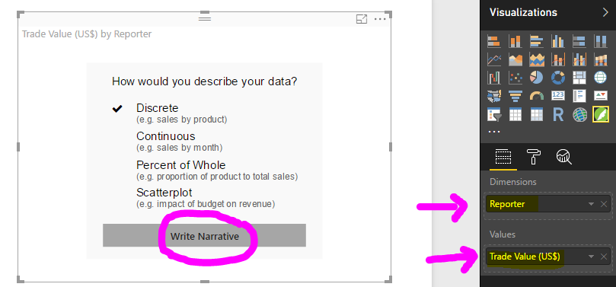
11. Learn narratives within Power BI Desktop
Review the video Read the insights hidden in your data (https://narrativescience.com/Partners/Business-Intelligence/Microsoft-Power-BI)
Import a custom visual (Visualizations => . . . => Import from store => Advanced Analytics => Narratives for Business Intelligence)
Drag contrade.Reporter into Dimensions and contrade.Trade value (US$) into Values
Write Narrative

Slide 14
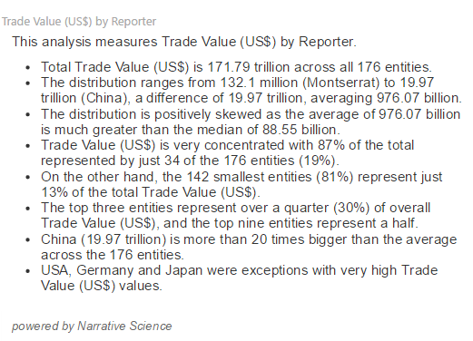
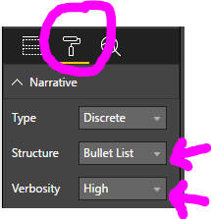
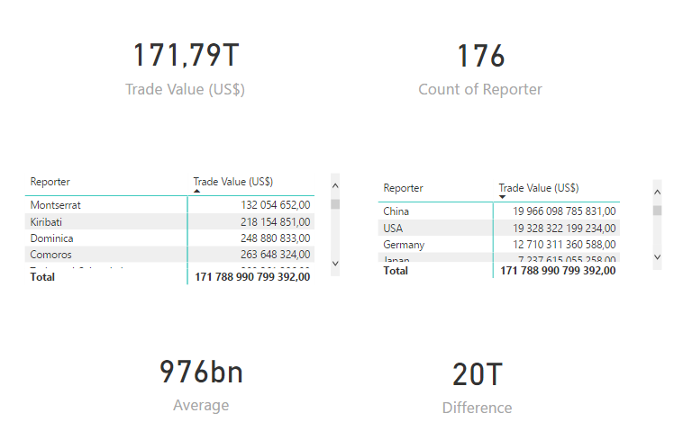
12. Learn to validate narratives
Change the narrative format as follows:
Structure => Bullet List
Verbosity => High
Use Card (Visualizations => Card) to validate the follows:
176 entities (i.e., Reporter)
176,9 trillion
Use Matrix (Visualizations => Matrix) to validate the follows:
Minimum value
Maximum value
Calculate by New Measure the follows:
Difference (Maximum – Minimum)
Average (Total / 176)

Slide 15
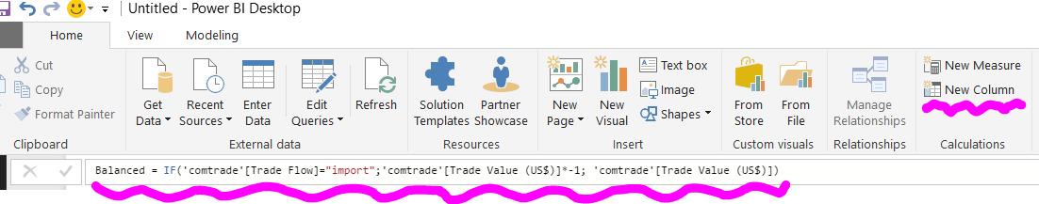
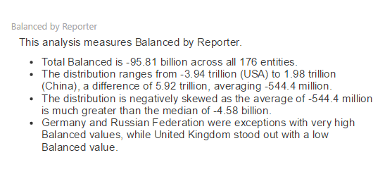
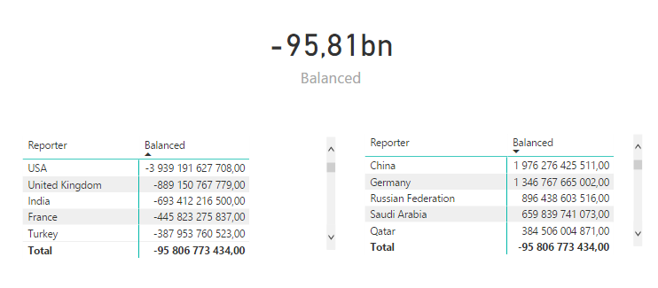
13. Learn to create conditional columns within Power BI Desktop
“The trade account describes the balance of foreign trade in goods in terms of exports and imports” (http://www.stat.fi/meta/kas/kauppatase_en.html).
Trade Value (US$) is always positive and Trade Flow describes is the value export or import one. Therefore, we have to create a new field in where we take the Trade Flow into the consideration.
Create New Column as follows:
Write Narrative by Balanced and validate it
Balanced = IF('comtrade'[Trade Flow]="import";'comtrade'[Trade Value (US$)]*-1; 'comtrade'[Trade Value (US$)])

Slide 16
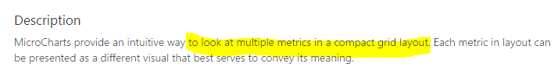
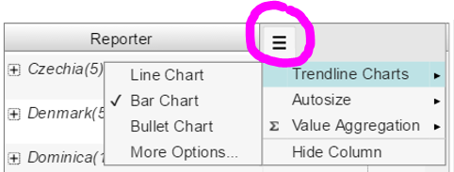
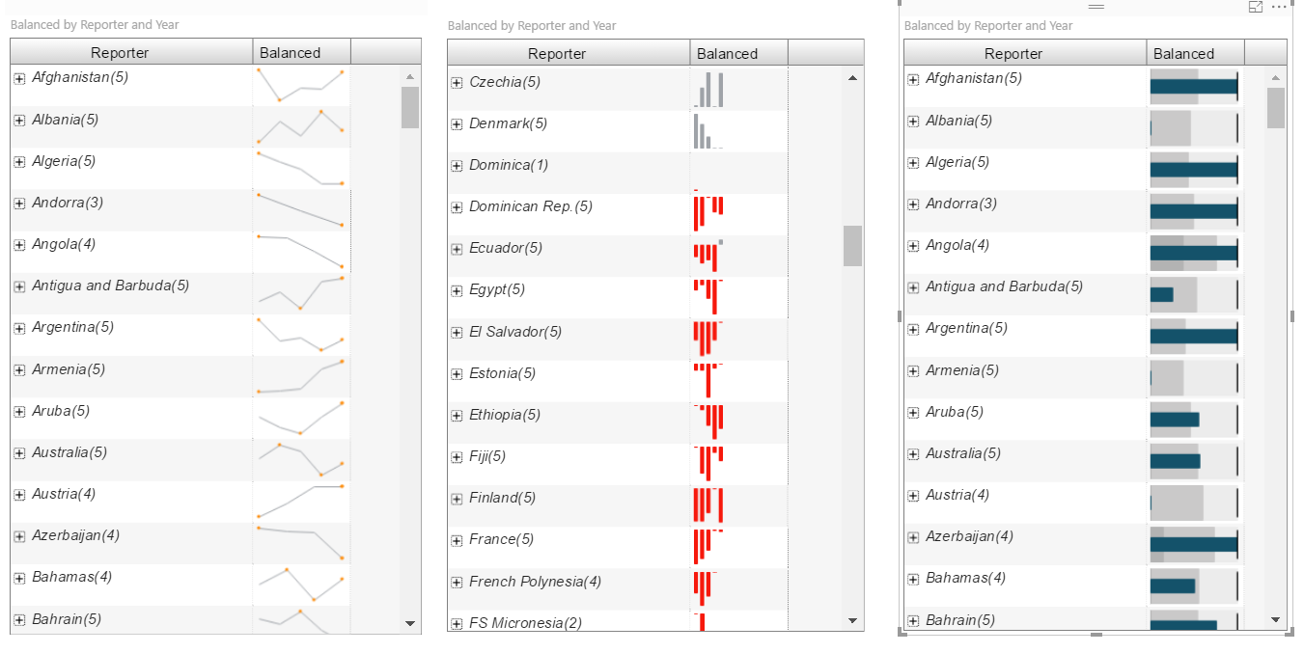
14. Learn micro charts within Power BI Desktop
Review the demo https://cloud.vitara.co:8553/VitaraChartsPlayLive/servlet/mstrWeb
Review the examples http://modeladvisor.com/general_use/ms_office_tools/data_visualization_dashboard/microcharts_pro_edition/microcharts_pro_edition.htm
Review Bullet graph (https://en.wikipedia.org/wiki/Bullet_graph)
Stephen Few invented the bulled graph as a replacement for gauges and speedometers.
Import a custom visual (Visualizations => . . . => Import from store => Advanced Analytics => VitaraCharts - MicroChart)
Drag contrade.Reporter into Category Axis, contrade.Year into Trend By, contrade.Balanced into Value
Illustrate within the fields three Trendline Charts
Micro charts provide a rich display of performance figures in the smallest of spaces.

Slide 17
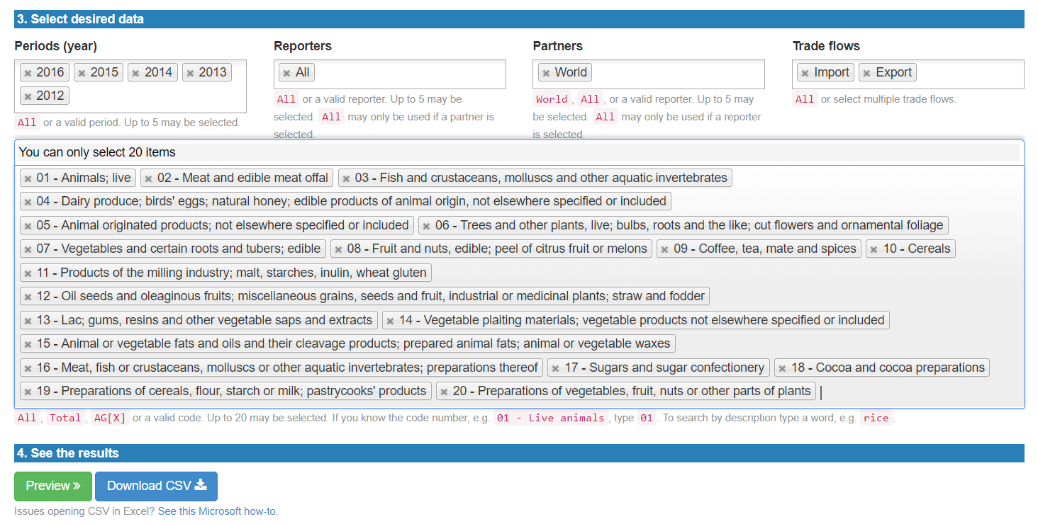
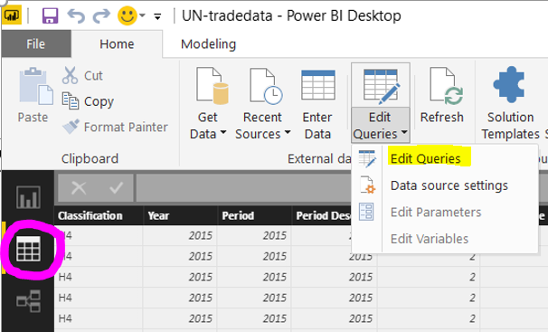

15. Learn to prepare datasets within Power BI Desktop
Download commodities using two digits commondity codes (there are not the codes 77 and 98) into the five files.
Import contrade (1).csv – contrade (5).csv (Get Data => Text/CSV)
Click Data => Edit Queries
Remove Columns from contrade (1) – contrade (5) – leave the columns Year, Trade Flow, Reporter Code, Reporter, Commondity Code, Commondity, and Trade Value (US$)

Slide 18



16. Learn to append tables within Power BI Desktop
Append tables contrade (1) – contrade (5) (Query Editor => Append Queries => Append)
Apply the changes by Close & Apply
Create New Column into Append1 as follows:
Validate the result within VitaraCharts - MicroChart
Balanced commodity = IF('Append1'[Trade Flow]="import";'Append1'[Trade Value (US$)]*-1;'Append1'[Trade Value (US$)])

Slide 19


17. Learn to make data model within Power BI Desktop
When we validate the result within VitaraCharts – MicroChart, then we realized that Commodity can vary (i.e., the commodity has one code but the descriptions differ). Therefore, we have to map Commodity Code within the dimension table in where each code has only one description.
Download the commondity codes http://unstats.un.org/unsd/tradekb/Attachment439.aspx?AttachmentType=1
Modify the sheet 2017-06-13 – leave the rows in where Classification is HO and change Code from Text to Whole Number
Click Relationships and connect 2017-06-13.Code within Append1.Commondity Code

Slide 20

18. Learn to apply data model within Power BI Desktop
Compara two microcharts (i.e., VitaraCharts – MicroChart)
Drag Append1.Commondity into Category Axis, Append1.Year into Trend By, Append1.Balanced commodity into Value
Drag 2017-06-13.Description into Category Axis, Append1.Year into Trend By, Append1.Balanced commodity into Value

Slide 21



19. Learn to find answers within filters in Power BI
Review https://comtrade.un.org/labs/dit-trade-vis/
Review https://comtrade.un.org/labs/data-explorer/
Learn to use filters/slicers (Enlighten Word Flags, Play Axis, Slicer and Attribute Slicer) and bar charts (Horizontal Bar – barChart, Stacked bas chart). Try to find out the answers to the following questions:
What are top 10 export commodities in Finland?
What are bottom 10 import commodities in Finland?

Slide 22



20. Learn to read data models
There are eight samples the data model of which illustrate relationships between the fact tables and dimensions ones (https://powerbi.microsoft.com/en-us/documentation/powerbi-sample-datasets/)
Select two or more datasets and figure out the data model (PowerPivot => Manage => Diagram View) and relationships (Design => Manage Relationships)

Slide 23

21. Learn R within R visualisations within Power BI
“R visuals that are created in Power BI Desktop, and then published to the Power BI service, for the most part behave like any other visual in the Power BI service” (https://powerbi.microsoft.com/en-us/documentation/powerbi-service-r-visuals/)
Review the video R Visualisations within Power BI (using R and Power BI) (https://www.youtube.com/watch?v=SMaJf6UBKeI)
Be aware the examples (http://community.powerbi.com/t5/R-Script-Showcase/bd-p/RVisuals)
Be aware the examples (https://www.rstudio.com/products/shiny/shiny-user-showcase/)
If you want, you can use R scripts/codes as a part of the dashboards. How you can use R in Power BI?

Slide 24


22. Learn correlations
Download Correlation Plot Showcase.pbix (https://community.powerbi.com/t5/R-Script-Showcase/Correlation-Plot/td-p/58462)
Review the explanations
Insert a new page and make similar correlation (start within importing Visualizations => . . . => Import from store => Advanced Analytics => Correlation plot and Chiclet Slicer)
Answer the following questions:
Does Discount correlated within Profit in all Product?
Does Discount correlated within Profit in all Segment?
Are there differences by Country?

Slide 25


23. Learn decision tree classifier
Download Decision Trees Showcase.pbix (http://community.powerbi.com/t5/R-Script-Showcase/Decision-Trees/m-p/58465)
Open the file within Power BI Desktop or upload within Power BI Service (i.e., cloud version)
Review the decision criteria

Slide 26
24. Learn accuracy and other metrics
Review Understanding How and Why Your Model Works (https://www.datascience.com/learn-data-science/fundamentals/model-interpretation-algorithms)
Review the video Probability and HIV Testing Accuracy (https://www.youtube.com/watch?v=pDsZ-7Y66QM)
Accuracy estimation techniques are such as cross-validation and bootstrap (http://www.dataschool.io/simple-guide-to-confusion-matrix-terminology/ and https://en.wikipedia.org/wiki/Confusion_matrix)
Calculate
Accuracy
Precision
Recall or Sensitivity
Specificity
Contingency table or confusion matrix or matching matrix | Classified /predicted died | Classified /predicted survived
Actual died | 681 | 128
Actual survived | 0 | 500
Contingency table or confusion matrix or matching matrix | Actual died | Actual survived
Classified /predicted died | 681 | 0
Classified /predicted survived | 123 | 500

Slide 27


25. Learn to validate decision tree classifier by filters
Open the file Decision Trees Showcase.pbix within Power BI Desktop or upload within Power BI Service (i.e., cloud version)
Import a custom visual (Visualizations => . . . => Import from store => Advanced Analytics => Decision tree)
Insert new page and make the decision tree
Apply Format settings Tree parameters and Advanced parameters
Review the packages rpart, rpart.plot and RColorBrewer to find out how Rel error, Cval error, Root error and cp are calculated

Slide 28

26. Learn clustering
Download Clustering Kmeans Showcase .pbix (http://community.powerbi.com/t5/R-Script-Showcase/Clustering/m-p/58476)
Open the file within Power BI Desktop or upload within Power BI Service (i.e., cloud version)
Review the clusters
Import a custom visual (Visualizations => . . . => Import from store => Advanced Analytics => Clustering with ourliers and Clusters)
Insert new page and make clusters
Apply Format settings Data preprocessing,Clusters defition and Visual appearance

Slide 29



27. Explain clustering
Use Clustering Kmeans Showcase .pbix
Exemplify dimensionality (i.e., apply Format settings)
Exemplify granularity (i.e., apply Format settings)

Slide 30




28. Learn associations
Review (http://community.powerbi.com/oxcrx34285/attachments/oxcrx34285/RVisuals/17/8/Association%20Rules%20Showcase_1.0.1.pbix)
Download Student from Moodle
Import a custom visual (Visualizations => . . . => Import from store => Advanced Analytics => Association rules)
Make different types of associations

Slide 31


29. Learn to forecast seasonality, trend and reminder (i.e., noise)
Download TS-decomp-Showcase.pbix (http://community.powerbi.com/oxcrx34285/attachments/oxcrx34285/RVisuals/107/4/TS-decomp-Showcase.pbix)
Interpret plot variations
Import a custom visual (Visualizations => . . . => Import from store => Advanced Analytics => Time series decomposition chart)
Insert new page and make forecasts
Apply Format settings Time series model and Algorithm parameters
Exemplify Decomposition model (additive and multiplicative) and Robust to outliers (i.e., LOESS procedure "LOcal regrESSion”)

Slide 32



30. Learn time series forecasting
Download TimeSeries.pbix (http://www.mrcube.net/SiteAssets/Pages/Resources/TimeSeries.zip)
Interpret plot variations
Import a custom visual (Visualizations => . . . => Import from store => Advanced Analytics => Time series forecasting)
Insert new page and make forecasts
Exemplify Forecasting settings

Slide 33



31. Learn ARIMA forecasting
Download forecast_ARIMA_ShowCase.pbix (http://community.powerbi.com/oxcrx34285/attachments/oxcrx34285/RVisuals/112/2/forecast_ARIMA_ShowCase.pbix)
Import a custom visual (Visualizations => . . . => Import from store => Advanced Analytics => Forecasting with ARIMA)
Insert new page and make forecasts
Apply Format settings for User defined model and set Sesonality = Off

Slide 34


32. Learn ARIMA forecasting
Download forecast_ARIMA_ShowCase.pbix (http://community.powerbi.com/oxcrx34285/attachments/oxcrx34285/RVisuals/112/2/forecast_ARIMA_ShowCase.pbix)
Import a custom visual (Visualizations => . . . => Import from store => Advanced Analytics => Forecasting with ARIMA)
Insert new page and make forecasts
Apply Format settings for Forecasting settings and set, for example, Forecast length = 100

Slide 35



33. Learn scatter (XY) plot and spline chart
Download Smoothing Splines Showcase.pbix http://community.powerbi.com/oxcrx34285/attachments/oxcrx34285/RVisuals/18/10/Smoothing%20Splines%20Showcase.pbix
Import a custom visual (Visualizations => . . . => Import from store => Advanced Analytics => Spline chart) and find out trends
Review Scatter charts and bubble charts in Power BI (Tutorial) (https://powerbi.microsoft.com/en-us/documentation/powerbi-service-tutorial-scatter/)
”you can create a field that concatenates your X and Y values together into something unique per point . . . Use the Query Editor to add an Index Column to your dataset. Then add this column to the Details [or Legend] area of your visualization”
If it is not allowed to edit queries then you will create an index within the following (http://community.powerbi.com/t5/Desktop/Add-an-index-column-to-a-summarised-table/td-p/204905)
Index = CALCULATE (
COUNTROWS ('presidents');
FILTER (
'presidents';
'presidents'[Date Index] <= EARLIER ( presidents[Date Index])
)
)
Illustrate the following:
Relatioships among measures (i.e., behave in relation to one another)

Slide 36

34. Be aware NLP and learn word cloud
Review Introduction to Natural Language Processing (https://www.datascience.com/learn-data-science/fundamentals/introduction-to-natural-language-processing-lexical-units-data-science)
Upload Word cloud.pbix from Moodle
Change Format options and learn to form word cloud

Slide 37


35. Learn to compare accuracies of the classifiers (neural network and decision tree)
Upload Neural Network.pbix from Moodle
Make Desicion tree
Compare the classifiers within accuracy

Slide 38

36. From trees to networks – be aware
Review the video A visual history of human knowledge (https://www.ted.com/talks/manuel_lima_a_visual_history_of_human_knowledge)
Review Neural network zoo (http://www.asimovinstitute.org/neural-network-zoo/ )
Explain the differences between trees and networks

Slide 39



37. Learn regression within Excel
Review (https://www.wikihow.com/Sample/Regression-Analysis) and (https://www.wikihow.com/Sample/Regression-Analysis-for-Blood-Pressure)
Review the video Explanation of Regression Analysis Results (https://www.youtube.com/watch?v=c5blVUkkjTM)
Use Student from Moodle and make the regression that predict University index
Explain the results of the regression
Review http://keydifferences.com/difference-between-correlation-and-regression.html

Slide 40

38. Learn optimization with Excel Solver
Review Optimization Methods in Management Science (https://ocw.mit.edu/courses/sloan-school-of-management/15-053-optimization-methods-in-management-science-spring-2013/tutorials/MIT15_053S13_tut03.pdf)
Follow the instructions and ”find a minimum-cost diet that contains at least 500 calories, at least 6 grams of chocolate, at least 10 grams of sugar, and at least 8 grams of fat”
Interpret the results. Use Step-By-Step Optimization with Excel Solver (http://excelmasterseries.com/D-_Loads/New_Manuals/Step-By-Step_Optimization_S.pdf)
Make a new dataset having dietary fibers, calories, fat and proteins. The objective is to find a maximum fiber diet at least 1500 calories, at least 25 grams of fiber and at least 100 grams of protein.

Slide 41
39. Datasets
Sometimes data is transactional (https://simplicable.com/new/transactional-data).
Find one time-stamped dataset and one dataset in where are at least five dimensional variables and three measures. You will use those datasets in your diploma work.
You can use the following:
https://mran.microsoft.com/documents/data/
https://data.europa.eu/euodp/en/data/
https://archive.ics.uci.edu/ml/datasets.html?format=&task=&att=&area=&numAtt=&numIns=&type=&sort=dateDown&view=table

Slide 42


40. Be aware IBM Watson analytics
Review Getting started with Watson Analytics (https://community.watsonanalytics.com/wp-content/uploads/2016/07/Tutorial-about-Watson-Analytics-2016-07-29.pdf) and the video Discovering insights in IBM Watson Analytics (https://www.youtube.com/watch?v=UMAe-R7gi7E&feature=youtu.be)
Go through Watson Analytics 101 (https://cognitiveclass.ai/courses/introduction-watson-analytics/) => Module 5 - Discover patterns, relationships, and predictive insights (free online course).
Download IBM_HR_Training_2014-17.csv (human resources training data set from https://www.ibm.com/communities/analytics/watson-analytics-blog/human-resources-training/)
How much the Customer Service department has been paid form the courses? What are top 10 Position?

Slide 43

41. Learn to leverage up-to-date data
Review the video Live Data Streaming in Power BI (https://www.youtube.com/watch?v=0YIBHfgasok)
Review Real-time streaming in Power BI (https://powerbi.microsoft.com/en-us/documentation/powerbi-service-real-time-streaming/ ) and Create Realtime Charts and Graphs with Microsoft Power BI (https://www.pubnub.com/tutorials/microsoft-power-bi/streaming-business-data-to-dashboards/)
Follow the instructions and feed PubNub data streams into Power BI Service

Slide 44


42. Be aware the cognitive services for tones and traits, as well as, for images, videos and others
Review https://azure.microsoft.com/en-us/services/cognitive-services/ and https://www.ibm.com/watson/products-services/
Write your own text and analyze it within IBM Tone Analyzer and IBM Personality Insights

Slide 45

43. Learn to use the cognitive service API
Review http://theexcelclub.com/sentiment-analysis-with-power-bi-and-microsoft-cognitive-services/
Follow the instructions and make sentiment analysis

Slide 46


44. Learn to test APIs
Open Graph API Explorer (https://developers.facebook.com/tools/explorer/) and click Get Token and copy the following jukolanviesti/tagged?fields=from,message,created_time,status_type,link,picture,likes and Submit
You will get (and test) data from public ID such as itasuomenyliopisto.uef/tagged?fields=from,message,created_time,status_type,link,picture,likes
Review Tutorial: Facebook analytics using Power BI Desktop (https://powerbi.microsoft.com/en-us/documentation/powerbi-desktop-tutorial-facebook-analytics/)
Use your own query and figure out message variation through time

Slide 47

45. Be aware AI
Review the video Introduction to Artificial Intelligence Ecosystem (https://vimeo.com/167156248). Explain the core meanings (i.e., advise, assess and predict) of AI.

Slide 48

46. Be aware Business Intelligence and Analytics Platforms
Review Magic Quadrant for Business Intelligence and Analytics Platforms (https://cdn2.hubspot.net/hubfs/2172371/Q1%202017%20Gartner.pdf?t=149626062) and Modern BI Evaluation Guide. Learn to compare the BI&A tools (https://www.panorama.com/read-modern-bi-evaluation-guide/). If you will evaluate BIAs what you should take into consideration?

Slide 49

47. Be aware Data Science Platforms
Review Gartner 2017 Magic Quadrant for Data Science Platforms: gainers and losers (https://www.kdnuggets.com/2017/02/gartner-2017-mq-data-science-platforms-gainers-losers.html) and Review Top 24 predictive analytics software (https://www.predictiveanalyticstoday.com/top-predictive-analytics-freeware-software/) and Review Top 30 Predictive analytics software API (https://www.predictiveanalyticstoday.com/top-predictive-analytics-software-api/). If you will evaluate data science platforms what you should take into consideration?

Slide 50

48. Be aware enterprise data platforms and open science platforms
Review the article Packaging data analytical work reproducibly using R (and friends) (https://doi.org/10.7287/peerj.preprints.3192v1). What is a compendium?
Review Open Data Science in the AI Era: Breaking Data Science Open (https://www.slideshare.net/continuumio/open-data-science-in-the-ai-era-breaking-data-science-open). What is open core and open source?
Review Breaking Data Science Open How Open Data Science Is Eating the World (http://know.continuum.io/rs/387-XNW-688/images/ebook-breakingdatascienceopen.pdf) and How to use DevOps for Data Science (https://www.datascience.com/blog/devops-data-science?utm_source=hs_email&utm_medium=email&utm_content=57181567&_hsenc=p2ANqtz-9AIFaw7KRLXBKDzk-lWEyKk0s5xIj-tVYrdC1kiUx6eQuYviUNnjqrvwbzavZh_7xjVuCx-nSkjPVMkTzasakDQRtXNQ&_hsmi=57181567). Why containers are leveraged in data science?

Slide 51


49. Be aware deep learning models and open AI tools/toolkits
Microsoft Cognitive Toolkit (https://www.microsoft.com/en-us/cognitive-toolkit/) is production-ready open source AI toolkit that is designed to work with Anaconda and it is used in Bing, Cortana and Skype.
Review (https://www.microsoft.com/en-us/cognitive-toolkit/features/model-gallery/) and try to find out do they leverage generative models and discriminative models or something else.
Review Supercharging Excel with Anaconda Fusion | Christine Doig & Fabio Pliger |AnacondaCON 2017 (https://www.youtube.com/watch?v=wBHf1PLzLvg)
When Anaconda Fusion (going to be Excel add-in) is available then you will review the demos (https://continuumio.github.io/anaconda-fusion-demos/)

Slide 52

50. Be aware cheat sheets, galleries, etc.
Make own contruction (e.g., mindmap, picture or table) that help you to get insights from data
Argument within MOD (http://mod.rapidminer.com/#app) and 50+ Data Science, Machine Learning Cheat Sheets, updated (https://www.kdnuggets.com/2016/12/data-science-machine-learning-cheat-sheets-updated.html)
In-depth introduction to machine learning in 15 hours of expert videos (https://www.r-bloggers.com/in-depth-introduction-to-machine-learning-in-15-hours-of-expert-videos/ ) and The Evolution of Analytics (book in Moodle) might help you
Exemplify your contruction within the examples such as
http://community.powerbi.com/t5/Data-Stories-Gallery/bd-p/DataStoriesGallery
https://gallery.cortanaintelligence.com/browse

